Slide 1
2023 Fourth Quarter Outlook
Bears Peek from Dens as Economy Brightens
<Enter Date>
--Rep Name
--Firm-Approved Title
--Registered Branch Address
--Approved Email and/or Registered Phone
--Securities Disclosure
Enter all information above and submit to Ad Review for final approval
Notes:
Introduction

Slide 2
What We Will Be Watching In the Fourth Quarter
Economy
The Fed
markets
Notes:
Three areas of focus for the fourth quarter, will be the economy, the Fed and markets.

Slide 3
Economy
Notes:
Economic data has been surprising to the upside most of this year. Surveys given to business leaders in both the manufacturing and service sectors appear to be improving, while inflation is moderating. Additionally, the labor market is moderating which is good news because labor market imbalances were fueling wage inflation.

Slide 4
Recession Risk High, but Trend is Positive
Notes:
Economic resilience has been the theme of this year. Economic data has largely surprised to the upside, just as we predicted in our 2023 Outlook, albeit sooner than we had anticipated. We publish a quarterly chartbook where we gauge the risk of an upcoming recession and look at the trend of the economic data. While the risk of recession is still high, the data is getting better.
We have spoken in lengths about the different recession scenarios. Will we experience a deep or shallow recession or no recession at all? While we have been more tempered in our outlook, calling for a shallow recession at some point in the next year, the idea of no recession is gaining traction with economists. As a reminder, a recession is a significant decline in economic activity spread across the economy that lasts longer than a few months. The reason this is feared, is because when economic activity slows, companies are forced to lay off workers and profits for companies also fall when people cut back on spending.

Slide 5
Upside Surprises
Notes:
Looking at the Citi Economic Surprise Index, economic data has beaten expectations since late May and most of this year. This has many economists changing their outlooks for a recession. Could the U.S. economy avoid a broad-based recession, as different areas of the economy go into a recession at different times (a rolling or sector recession)?

Slide 6
Business Surveys
Notes:
Looking at surveys of business leaders in manufacturing and service industries, their outlooks are improving. While the manufacturing industry is below 50 and signaling contraction, it is getting closer to 50 and more importantly the service sector remains in expansion territory. As a reminder the U.S. economy is predominantly a service economy. Services make up over 75% of U.S. GDP.

Slide 7
Even Bad Economic Data, is Good News
Notes:
Giving even more credence to a rolling or sector recession, is that inflation data continues to moderate and so does the labor market. This is evidenced in the quits rate, a metric that the Fed has been looking at closely. People generally don’t quit their jobs to move to another employer unless they can make more money, so if the quit rate is falling it can tell us that potential workers are not being offered as much money, which is good for softening wage inflationary pressures.

Slide 8
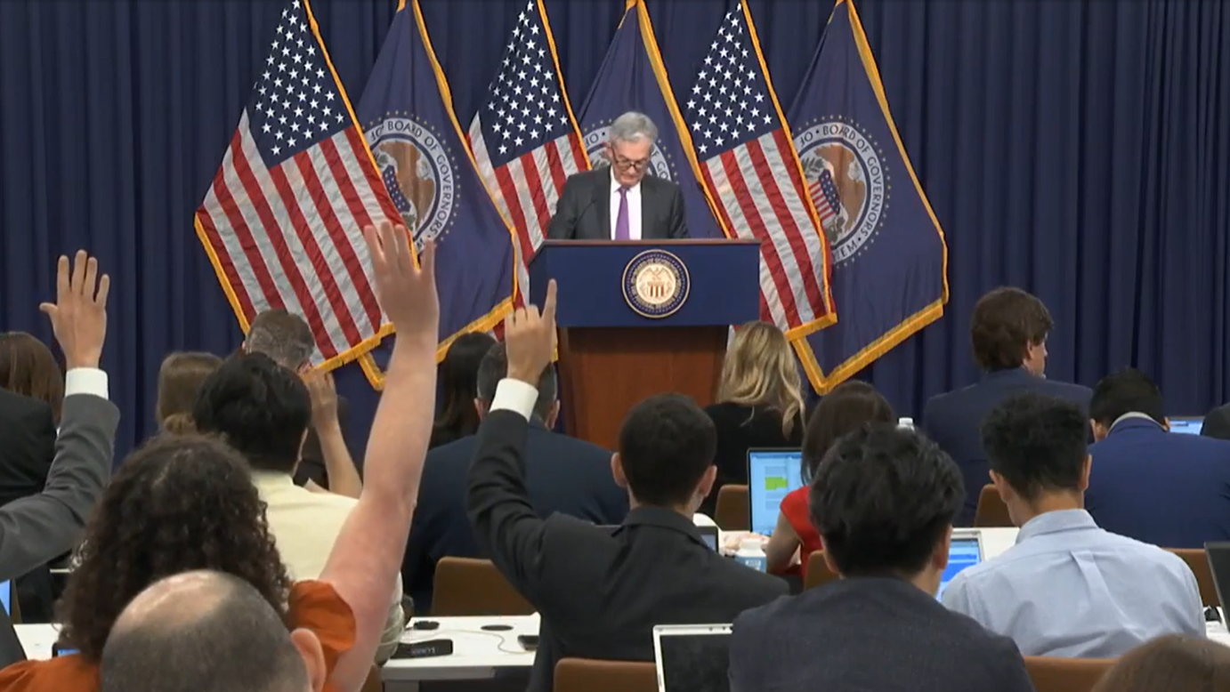
The Fed
Notes:
While the Fed appears to be balancing inflation and the labor market well at this point in time. That can change quickly. The Fed appears to be done with rate hikes, but policy errors could remain as they are committed to keep rates higher for longer.

Slide 9
Inflation
Notes:
Inflation could be under control, although it may not feel that way. Keep in mind inflation is the pace of price increases. Prices are rising more slowly now, but unfortunately for many consumers prices are not falling in most categories. So, one should not expect to go back to 2019 prices. If we look at core CPI, which the Fed is more interested in because it strips out volatile food and energy metrics, you can see the last few months of inflation have been relatively low. If we annualize the last three months (through August), we get core CPI inflation rising at just a 2.4% annual pace. If we look to bond markets, they are also expecting inflation is under control. Bond investors are very sensitive to inflation because it erodes their fixed returns. Treasury Inflation Bonds are priced so investors will break even with inflation rates around 2.25% for both 5-year and 10-year bonds.

Slide 10
Job Openings are Falling
Notes:
Job openings are falling but are still above pre-pandemic levels. This is good news for wage inflation as companies will have less competition for qualified candidates. We still don’t know the full impact of a tightening labor market and higher financing costs on the consumer.

Slide 11
Oil Prices Rising Again
Notes:
But just as it appears that the Fed has inflation under control, something the Fed can’t control is lurking. Oil prices are rising again and while the Fed tries not to look at inflation that includes food and energy prices because they are more volatile, high oil prices can feed into other inflation categories because most all goods require transportation that tends to rely on petroleum products.

Slide 12
Markets
Notes:
However, bond and equity markets could already be anticipating a Fed pause

Slide 13
Relative Valuations
Notes:
Higher for longer interest rates could become an issue for higher valuation areas of the market such as growth.
One way to measure whether a stock is overvalued or undervalued is to look at the stock’s price relative to its earnings or expected future earnings. Comparing growth stocks relative to value stocks there hasn’t been this wide of discrepancy in valuations since the dot com bubble. Growth stocks have much higher valuations relative to value stocks. Growth stocks on average since 2001 have a P/E ratio that is around 1.5 times higher than value stocks. Today, it is over 2 times higher.

Slide 14
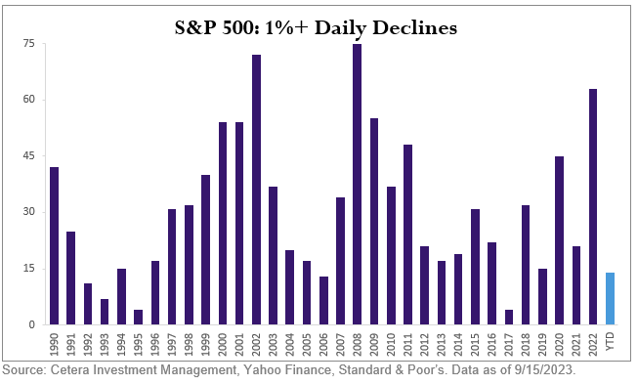
Lack of Volatility
Notes:
With uncertainty around when the Fed would pause its rate hikes and what impact those rate hikes would have on the economy, we expected more volatility. This slide shows the number of daily 1% declines by year in the S&P 500. On average the S&P 500 falls 1% or more 31 times a year since 1990. While last year we had 63 such declines, we have only had 14 this year as of this writing. Markets can change quickly, but thus far markets have been climbing a wall of worry as the old Wall Street adage goes.

Slide 15
Yields Are Rising
Notes:
Looking to bonds, the 10-year Treasury yield rose from 3.88% to now around 4.3%. With around a 0.5% rise in yields on these long-dated bonds, this would cause around a 4% price loss in those bonds. But bond investors have already received about 3% in coupon payments this year, so the loss for 2023 is currently roughly 1%. If yields remain stable one can expect returns to be like the current yields. If yields fall, bond investors could see returns that they have not seen in decades. However, higher for longer interest rates and rising oil prices could push yields higher or at least keep them at these levels.

Slide 16
Thank You
For more recent updates follow us on Twitter @CeteraIM
Notes:
To recap, the U.S. economy has been resilient thus far in 2023, largely outpacing the rest of the world that is facing potential for stagflation and recession in some areas of the globe. While the economic data isn’t stellar, it is improving off the lows to the point many economists are starting to think a recession could be avoided.
The outlook for stocks and bonds will be driven around the Fed’s ability to navigate the changing economic landscape. Can the Fed manage to tame inflation and not cause a recession? And will the Fed lower rates soon enough after inflation is under control? However, the second half of that question will likely be answered in 2024. Meanwhile, valuations, which can remain elevated or depressed for long periods of time, are elevated in large cap growth stocks. Valuations for value stocks, small company stocks and international stocks are more attractive. These can offer good entry points for long-term investors. Within bonds, rising yields can create better return opportunities offering some protection if yields rise further. Bonds could offer good diversification if inflation moderates, economic growth slows, or when the Fed cuts rates.
As always, count on your Cetera financial professional to help you through these volatile times and keep you focused on your personal goals and objectives.
Thank you

Slide 17
Disclosures
About Cetera® Investment Management
Cetera Investment Management LLC is an SEC registered investment adviser owned by Cetera Financial Group®. Cetera Investment Management provides market perspectives, portfolio guidance, model management, and other investment advice to its affiliated broker-dealers, dually registered broker-dealers and registered investment advisers.
About Cetera Financial Group
“Cetera Financial Group” refers to the network of independent retail firms encompassing, among others, Cetera Advisors LLC, Cetera Advisor Networks LLC, Cetera Investment Services LLC (marketed as Cetera Financial Institutions or Cetera Investors), and Cetera Financial Specialists LLC. All firms are members FINRA / SIPC. Located at 655 W. Broadway, 11th Floor, San Diego, CA 92101.
Individuals affiliated with Cetera firms are either Registered Representatives who offer only brokerage services and receive transaction-based compensation (commissions), Investment Adviser Representatives who offer only investment advisory services and receive fees based on assets, or both Registered Representatives and Investment Adviser Representatives, who can offer both types of services.
The material contained in this document was authored by and is the property of Cetera Investment Management LLC. Cetera Investment Management provides investment management and advisory services to a number of programs sponsored by affiliated and non-affiliated registered investment advisers. Your registered representative or investment adviser representative is not registered with Cetera Investment Management and did not take part in the creation of this material. He or she may not be able to offer Cetera Investment Management portfolio management services.
Nothing in this presentation should be construed as offering or disseminating specific investment, tax, or legal advice to any individual without the benefit of direct and specific consultation with an investment adviser representative authorized to offer Cetera Investment Management services. Information contained herein shall not constitute an offer or a solicitation of any services. Past performance is not a guarantee of future results.

Slide 18
Disclosures
For more information about Cetera Investment Management, please reference the Cetera Investment Management LLC Form ADV disclosure brochure and the disclosure brochure for the registered investment adviser your adviser is registered with. Please consult with your adviser for his or her specific firm registrations and programs available.
No independent analysis has been performed and the material should not be construed as investment advice. Investment decisions should not be based on this material since the information contained here is a singular update, and prudent investment decisions require the analysis of a much broader collection of facts and context. All information is believed to be from reliable sources; however, we make no representation as to its completeness or accuracy. The opinions expressed are as of the date published and may change without notice. Any forward-looking statements are based on assumptions, may not materialize, and are subject to revision.
All economic and performance information is historical and not indicative of future results. The market indices discussed are not actively managed. Investors cannot directly invest in unmanaged indices. Please consult your financial advisor for more information.
Additional risks are associated with international investing, such as currency fluctuations, political and economic instability, and differences in accounting standards.
A diversified portfolio does not assure a profit or protect against loss in a declining market.

Slide 19
Glossary
The Russell 1000 Value index is a subset of the Russell 1000 as measured by three factors: the ratios of book value, earnings, and sales to price.
The S&P SmallCap 600 seeks to measure the small-cap segment of the U.S. equity market. The index is designed to track companies that meet specific inclusion criteria to ensure that they are liquid and financially viable.
The S&P 500 is a capitalization-weighted index of 500 stocks designed to measure performance of the broad domestic economy through changes in the aggregate market value of 500 stocks representing all major industries.
The ICE BofA US High Yield Index tracks the performance of US dollar denominated below investment grade rated corporate debt publicly issued in the U.S. domestic market. Securities must have a below investment grade rating (average of Moody's, S&P, and Fitch) and an investment grade rated country of risk (average of Moody's, S&P, and Fitch foreign currency long term sovereign debt ratings). Each security must have greater than 1 year of remaining maturity, a fixed coupon schedule, and a minimum amount outstanding of $100 million.
The MSCI EAFE is designed to measure large and mid cap equity market performance of 21 developed markets, including three regions (Europe, Australasia, Far East) excluding the U.S. and Canada. The Index is market-capitalization weighted, covering 85% of the free float-adjusted market cap in each of the 21 countries.
The MSCI Emerging Markets index is designed to measure large and mid cap equity market performance in global emerging markets. The Index is market-capitalization weighted, covering 85% of the free float-adjusted market cap in each of 24 countries.
The Russell 1000 index is a stock market index that tracks the top 1,000 stocks by market capitalization in the Russell 3000 Index, which represent about 90% of the total market capitalization of that index.

Slide 20
Thank You
For more recent updates follow us on Twitter @CeteraIM
Notes:
Thank you

